Slide 1
Chapter Basic Information Slides
The OWASP® Foundation

Slide 2
MISSION
The Open Web Application Security Project®(OWASP®) is a 501 c 3 worldwide non-profit charitable organization focused on improving the security of software. Our mission is to make software security visible, so that individuals and organizations are able to make informed decisions. OWASP® is in a unique position to provide impartial, practical information about AppSec to individuals, corporations, universities, government agencies, and other organizations worldwide. Operating as a community of like-minded professionals, OWASP® issues software tools and knowledge-based documentation on application security.
Everyone is free to participate in OWASP® and all of our materials are available under a free and open software license. You'll find everything about OWASP® here on the NEW owasp.org website. OWASP® does not endorse or recommend commercial products or services, allowing our community to remain vendor neutral with the collective wisdom of the best minds in software security worldwide.
Core Values
Open: Everything at OWASP is radically transparent from our finances to our code.
Innovative: We encourage and support innovation and experiments for solutions to software security challenges.
Global: Anyone around the world is encouraged to participate in the OWASP community.
Integrity: Our community is respectful, supportive, truthful, and vendor neutral
Notes:
The OWASP Foundation is a 501 c 3 nonprofit that was incorporated in the United States by Mark Curphey, September 9, 2001 and the Foundation was established in 2004. In 2011, OWASP is also registered as a non-profit organization in Belgium under the name of OWASP Europe VZW.
The new OWASP Website was launched on January 16, 2020 it is built on GitHub platform.

Slide 3
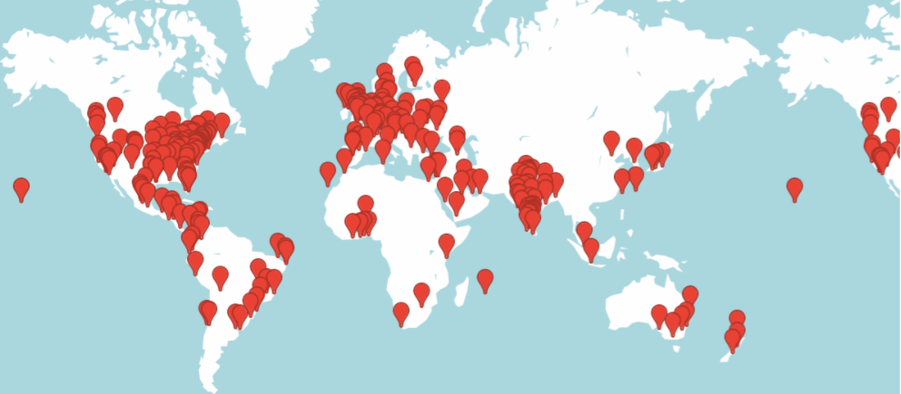
OWASP® Foundation World Wide
Countries Groups Members
67 245 71,259
Notes:
Current as of Oct 15, 2020 > this information can be found on the Chapter page > Important Links (right side) > OWASP Meetup
If you do not see your chapter listed on the OWASP Local Chapter page, under important link click on Chapter Status. These are the chapter pages that need attention.

Slide 4

Benefits of Becoming a Member
Networking and directory access
Flexible online learning discounts
Professional mentoring programs
Meaningful volunteer opportunities
Exclusive, industry-specific offers
Regional and full-time student special pricing is available
Visit: https://owasp.org/membership/
Member Lounge at OWASP Conference
Notes:
All leaders and community are accessible through various platforms ie. social media, owasp.org website, slack, Meetup and once COVID has past in person Global AppSec Conferences.
Virtual AppSec Days Summer of Security - June, July and August the Foundation hosted its first online virtual training sessions.
WIA offers mentoring
OWASP is also involved with Google Summer of Code
OWASP Committees - currently 6 and Global AppSec Program Teams
Discounts on industry conferences - BlackHat, DefCon, OWASP Global AppSec Conferences, Secure Flag
This is found on the Membership page of the website. The Membership page is located on the “About” drop down menu.

Slide 5
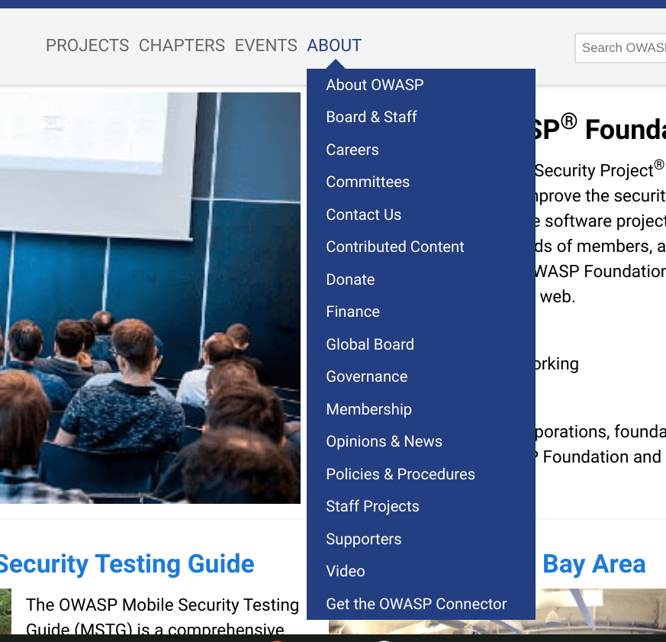

The New OWASP® Foundation Website
“About” s where majority of information is located.
Click on for drop down menus for project, chapter and event information
Notes:
About OWASP drop menu contains a list of important subject matter:
Board & Staff
Careers
Committees
Contact Us
Contributed Content
Donate
Finance
Global Board
Governance
Membership
Opinions & News
Policies & Procedures
Staff Projects
Supporters
Video
Get the OWASP Connector

Slide 6
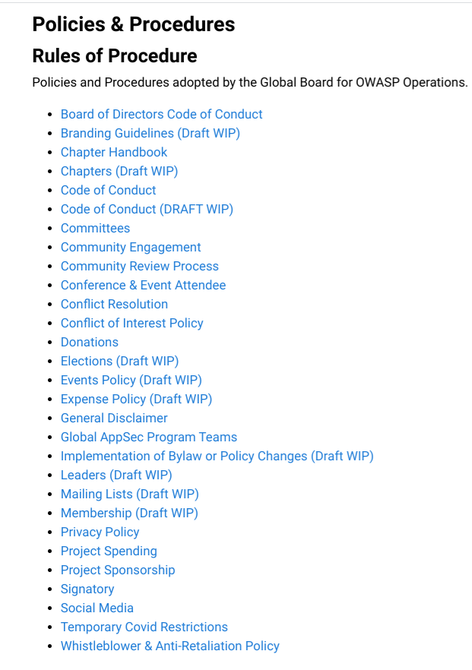
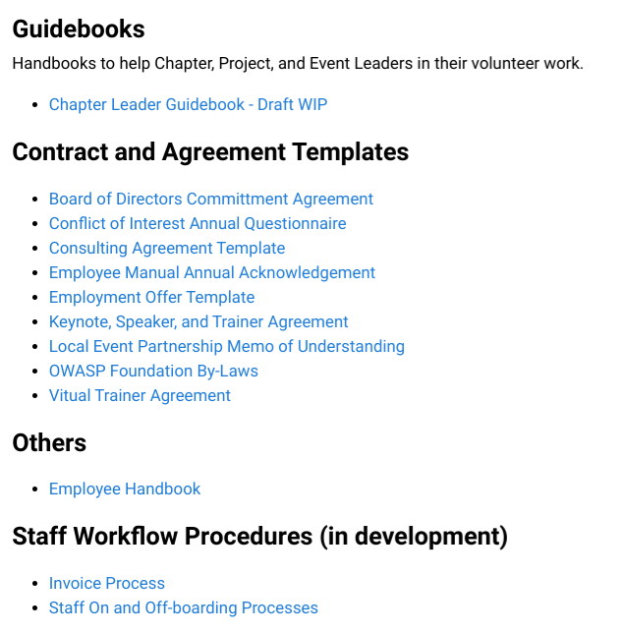
Policies and Procedures
Stay up to Date
ALL of the OWASP Foundation policies and procedures are centralized in one location.
This page will be reviewed and updated consistently to meet the financial and legal guidelines and requirements that affect the Foundation.
Temporary COVID Restriction Policy enacted 9/3/2020
Notes:
The Policies and Procedures can be found on the “About” drop down menu. All of the information contained on this page applies to the community at large. We are currently going through a review of all policies and procedures. Most have been reviewed updated and voted on. The DRAFT WIP are the ones remaining that in the process and should be completed sho
These slides can be found on this webpage > Branding

Slide 7
Membership
“You can Manage your Membership to provision an OWASP email address, check your renewal date or, for recurring donations and memberships, update billing details or cancel the recurring bill.”
The only information that will be displayed is the “Membership type and Membership end date.”
Self-provision your owasp.org email address
To access or renew your OWASP Membership, you “Must” use the same email address you entered when you registered/paid for a membership. This email address is your ID, and the receipt goes to this address.
Full-time student membership link at the bottom of the page under the “submit” button.
Special regional pricing coming soon for two and lifetime membership.
Notes:
Membership can be found on the “About” drop down Menu
Membership is a revenue stream that helps keep the Foundation and the OWASP mission going. During these difficult economic times every penny helps.
Finance
Annual Budget> 2020 COVID Response Budget

Slide 8
OWASP® Committees
List of Committees
OWASP Chapter Committee
OWASP Education and Training Committee
OWASP Outreach Committee
OWASP Project Committee
OWASP Compliance Committee
OWASP Women in AppSec (WIA) Committee
To encourage focus and participation, we recommend that volunteers contribute to one primary committee. Individuals are welcome to participate in whatever committee they would like but may only be officially elected to serve on one committee.
*Reminder you must be an OWASP Member to join a committee.*

Slide 9
Reminders
“Contact Us” As always, we suggest the best way to place a request is through the ticket system, which will log, track, and route it to the correct staff member. Anyone can create an account or multiple accounts using ANY email address. This is where you submit for Zoom account.
OWASP.org email addresses - Leaders & Members: All important Foundation information goes to the owasp.org email address for both members and leaders. If you do not check or Opted out of receiving emails, you will miss out on essential information. We suggest Opt-in for owasp.org email (especially leaders) and log in to the account consistently.
Problem or Complaint: The OWASP Compliance Committee is responsible for receiving and investigating complaints. The Compliance Committee can be reached by sending an email to compliance@owasp.org.
Since the OWASP Foundation is a 501c3 non-profit organization responsible for following specific financial and legal guidelines that can change, we have created a central repository called "Policies and Procedures". This repository holds all the information that all are responsible for following and abiding. We ask to direct back to the central repository as these are the approved policies that will be followed. We want to eliminate multiple and old versions of policies.
Notes:
Contact Us and Committee can be found on the “About” drop down menu.

Slide 10
Upcoming OWASP Events
Global Events
Global AppSec 2020 - Virtual
October 19-23, 2020
Registration Open
https://virtual.globalappsec.org
Regional Events
OWASP AppSec Israel 2020 - Virtual
October 27-28, 2020
https://appsecil.org/
AppSec Morocco & Africa 2020
November 5-6, 2020
Rabat, Morocco
https://appsecafrica.com/
Virtual AppSec Indonesia 2020
November 21-22, 2020
https://appsec2020.owasp.or.id/
Notes:
Check out OWASP Global and Regional Events

